Slide 1
Human Hack:
The Future of Consulting Culture
Dan Barber // Areti Iles // Ian Tweedie

Slide 2








THANK YOU
TO OUR SPONSORS
SOUTH COAST USER GROUP
23RD OCTOBER 2026

Slide 3

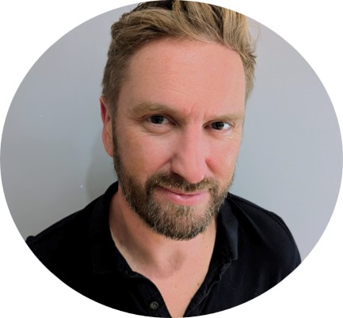



Contributors
SOUTH COAST
USER GROUP
23RD OCTOBER 2026
Dan Barber
Founder & Lead Consultant // Strathos
I bring unbiased, expert strategic leadership to grow Microsoft partners and tech-driven businesses by asking the tough questions, independent observation and driving change, so they can scale with confidence.​
Focus
Awards
Connect
Partner Growth & Advisory
AI Adoption
AI Business Applications
Dual MVP M365 Copilot & Biz Apps x 4 years

Slide 4
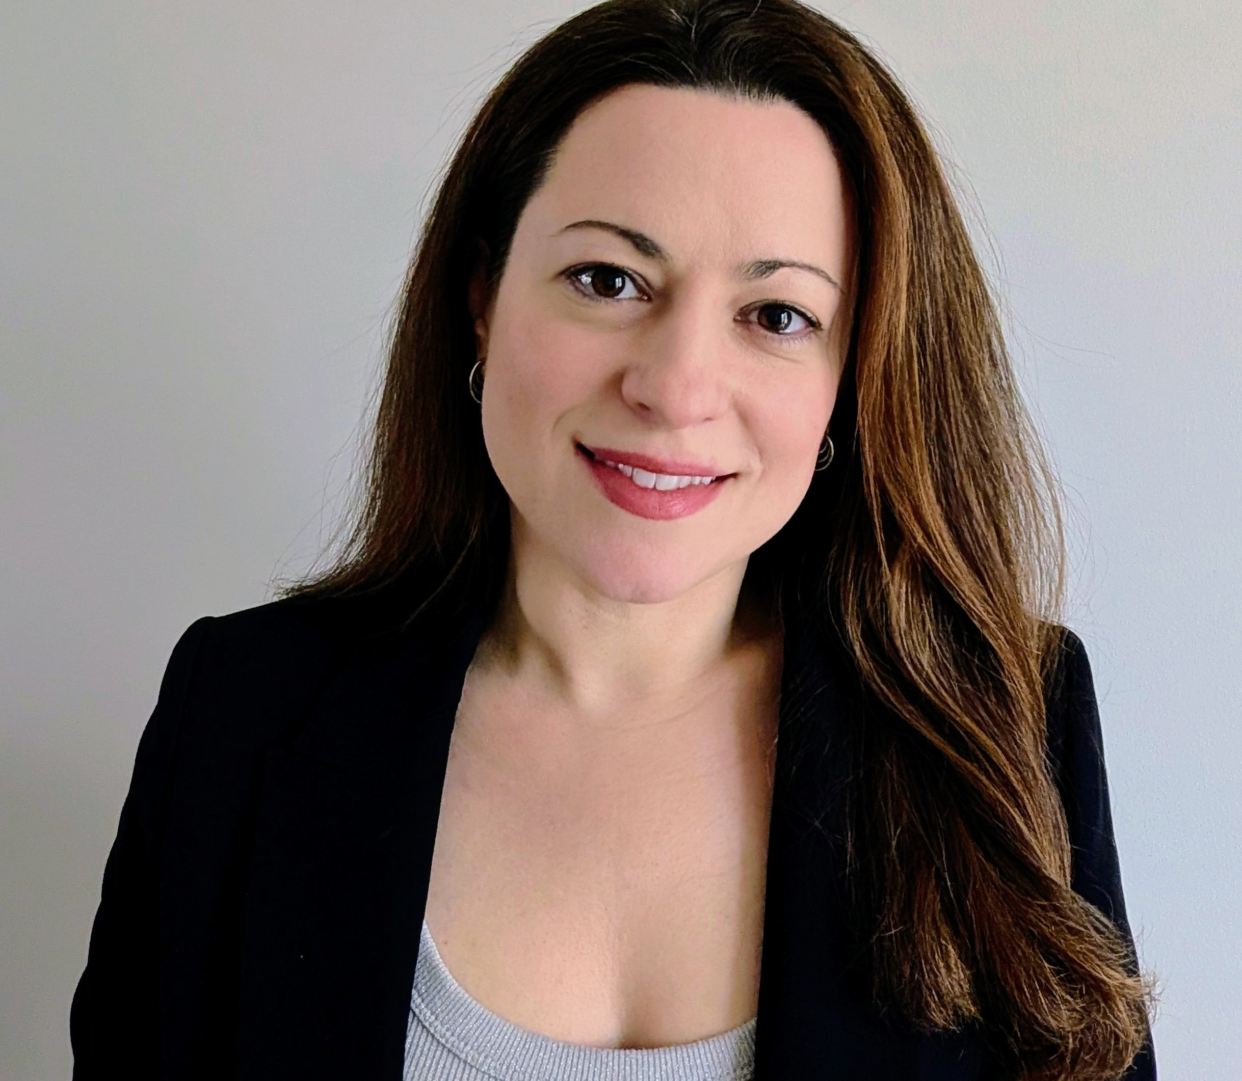


Contributors
SOUTH COAST
USER GROUP
23RD OCTOBER 2026
Areti Iles
Technology Director // Telefonica Tech
Focus
Awards
Connect
AI Business Applications
AI Compliance
AI Adoption
Microsoft MVP x2
BizApps Evangelist 2025
Community Hero 2024

Slide 5

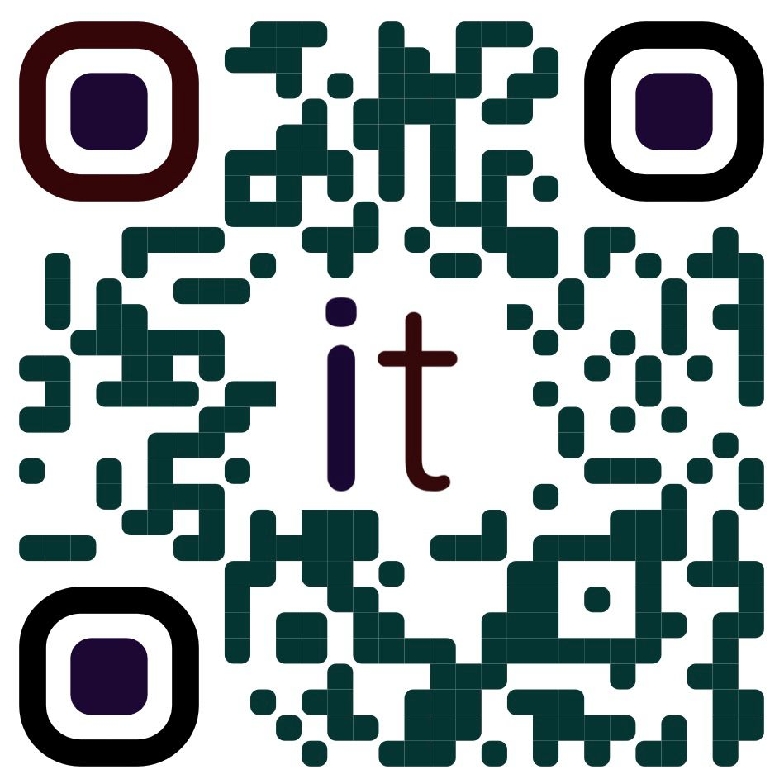
Contributors
SOUTH COAST
USER GROUP
23RD OCTOBER 2026
Ian Tweedie
Senior Solution Architect // Capgemini
I bring strategic and technical leadership to complex digital transformation, helping organisations get more from Microsoft Power Platform by challenging assumptions, simplifying complexity and connecting technology decisions to real business outcomes.
Focus
Awards
Connect
Delivery in Enterprise
Complex Architecture
Integrations
Dynamite Tech Awards, Peoples Choice 2025
BizApps Evangelist 2026

Slide 6


Slide 7
Discussion topics
SOUTH COAST
USER GROUP
23RD OCTOBER 2026
Delivery constraints
Competence and confidence
Rapport
Passion and requirement
Consulting mindset
Motivation
Elastic leadership
Conflict management
Situational leadership
Closing thoughts

Slide 8
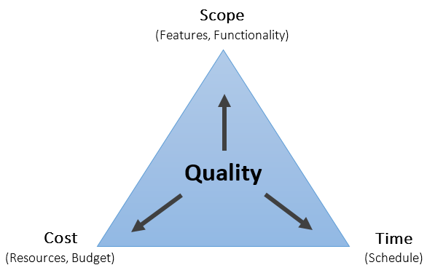
Scope, cost, time and quality
SOUTH COAST
USER GROUP
23RD OCTOBER 2026

Slide 9
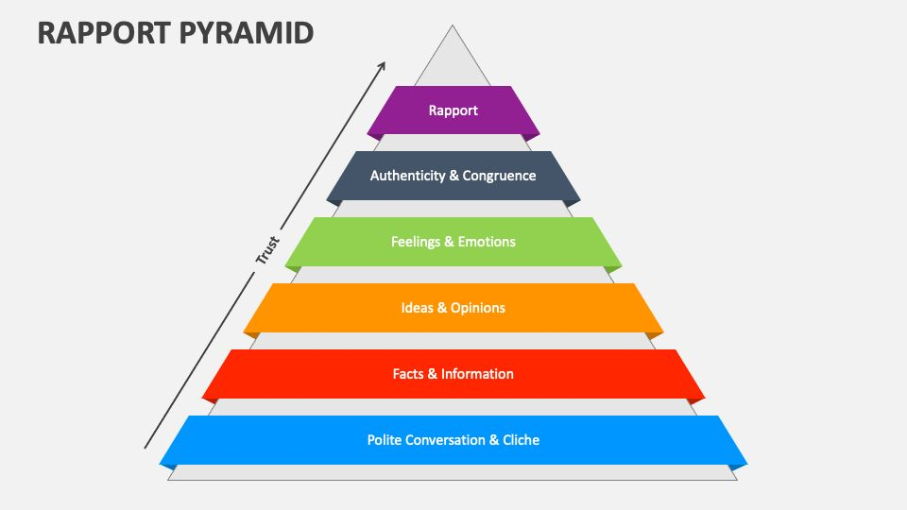
Rapport pyramid
SOUTH COAST
USER GROUP
23RD OCTOBER 2026

Slide 10

Mercenary Vs Missionary
SOUTH COAST
USER GROUP
23RD OCTOBER 2026
MERCENARY
Transactional relationships
Short-term wins
Order-taking
Metric driven decisions
Minimal challenge to the client
Output over outcomes
MISSIONARY
Purpose-first mindset
Long-term partnerships
Client empowerment
Challenging assumptions
Value creation
Human-centric engagement

Slide 11
Decisions shift with context
SOUTH COAST
USER GROUP
23RD OCTOBER 2026
Each dot is a decision — context shifts where it lands.
MERCENARY
MISSIONARY
reward-led
purpose-led
The stance is fluid — not a fixed identity.

Slide 12
Decisions shift with context
SOUTH COAST
USER GROUP
23RD OCTOBER 2026
Each dot is a decision — context shifts where it lands.
MERCENARY
MISSIONARY
reward-led
purpose-led
The stance is fluid — not a fixed identity.

Slide 13
Effort follows purpose and ownership
SOUTH COAST
USER GROUP
23RD OCTOBER 2026
Consultants move by situation, each dot is a moment, not a fixed identity.
EFFORT FOR REWARD
DISCRETIONARY OWNERSHIP
EFFORT FOR IMPACT
Outcome aligns with values
MERCENARY
MISSIONARY
reward-led
purpose-led
BARE MINIMUM
BELIEF, BUT CONSTRAINED
MINIMUM COMPLIANCE
The same consultant can move around the map as purpose, autonomy and incentives change.

Slide 14
Effort follows purpose and ownership
SOUTH COAST
USER GROUP
23RD OCTOBER 2026
Consultants move by situation — each dot is a moment, not a fixed identity.
EFFORT FOR REWARD
DISCRETIONARY OWNERSHIP
EFFORT FOR IMPACT
Bonus or promotion
Outcome aligns with values
Protect the client
MERCENARY
MISSIONARY
reward-led
purpose-led
Boss's vanity project
Purpose clear, autonomy low
BARE MINIMUM
BELIEF, BUT CONSTRAINED
MINIMUM COMPLIANCE
The same consultant can move around the map as purpose, autonomy and incentives change.

Slide 15
Elastic Leadership
SOUTH COAST
USER GROUP
23RD OCTOBER 2026
Leadership style changes as team capability grows.
SURVIVAL MODE
LEARNING MODE
SELF-ORGANIZING
1
2
3
Command style
Coach
Facilitator
Control gives way to coaching, then facilitation.
Source: Roy Osherove, Elastic Leadership: Growing Self-Organizing Teams

Slide 16
Self-organization is built in stages
SOUTH COAST
USER GROUP
23RD OCTOBER 2026
Stabilize the system first; then distribute decisions and build capability.
1
2
3
SURVIVAL MODE
LEARNING MODE
SELF-ORGANIZING
SURVIVAL → LEARNING
LEARNING → SELF-ORGANIZING
Make work visible
Delegate decisions (RACI)
WIP limits • Fix-the-build • Code review • Small batches
Define guardrails • Outcomes • Rotating ownership
Run a stabilization sprint
Add coaching for new tech or capability gaps
Stop-the-line • Reduce WIP • Reinstate hard constraints
Pairing • Learning cadence
Source: Roy Osherove, Elastic Leadership: Growing Self-Organizing Teams

Slide 17
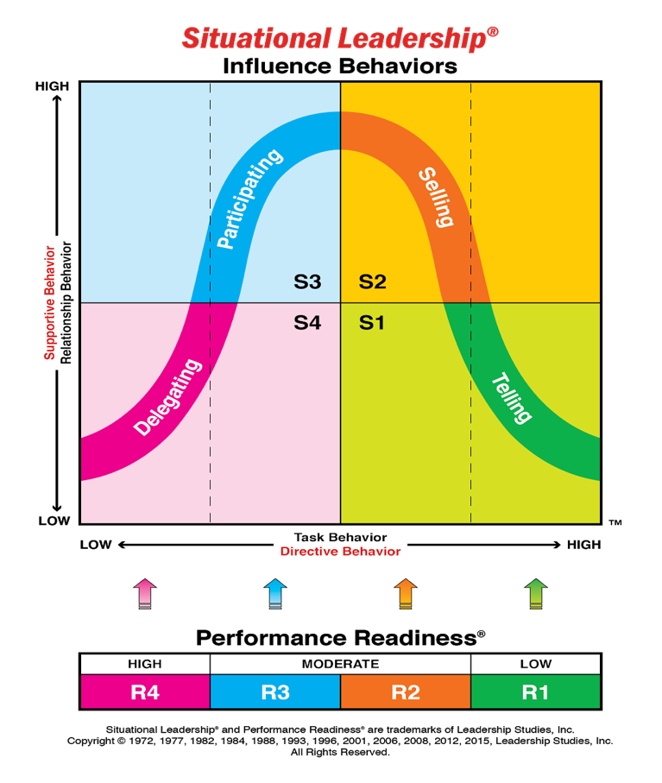
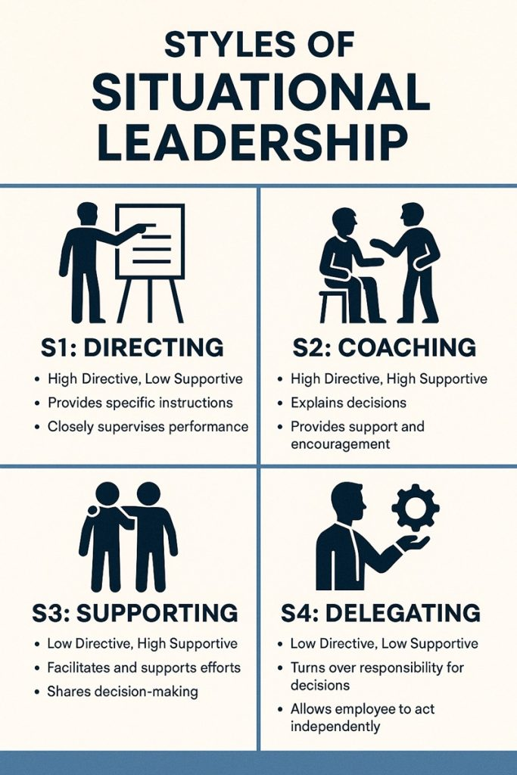
Situational leadership
SOUTH COAST
USER GROUP
23RD OCTOBER 2026

Slide 18
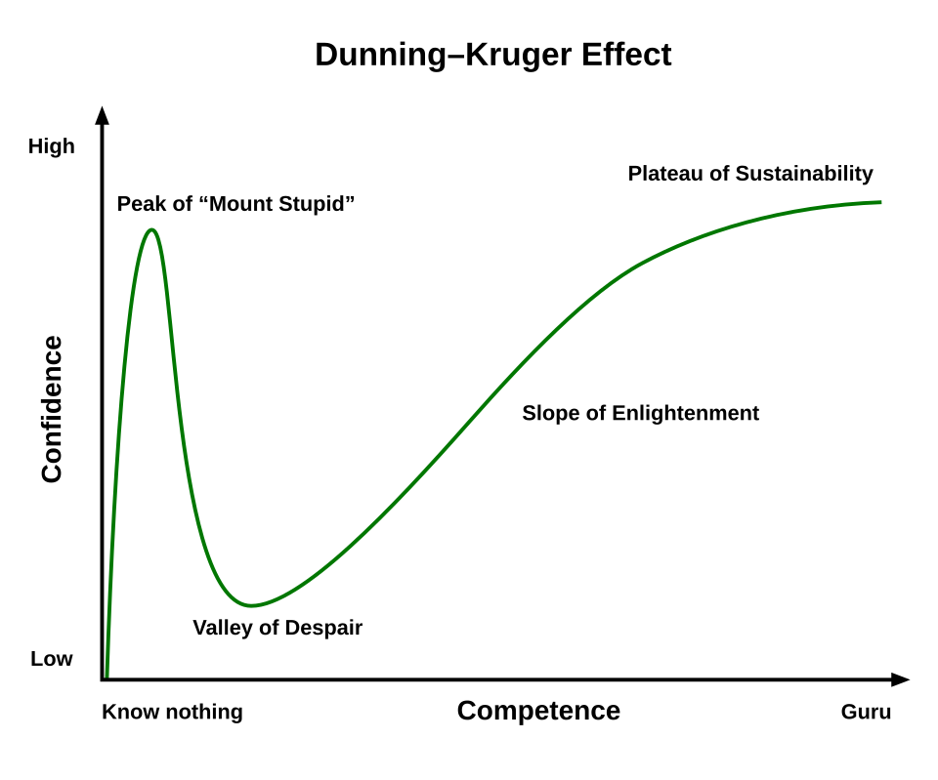
Dunning–Kruger effect
SOUTH COAST
USER GROUP
23RD OCTOBER 2026

Slide 19
Passion and requirement
SOUTH COAST
USER GROUP
23RD OCTOBER 2026
3
1
I don’t need to know
I do want to know
I do need to know
I do want to know
Passion
I don’t need to know
I don’t want to know
I do need to know
I don’t want to know
4
2
Requirement

Slide 20
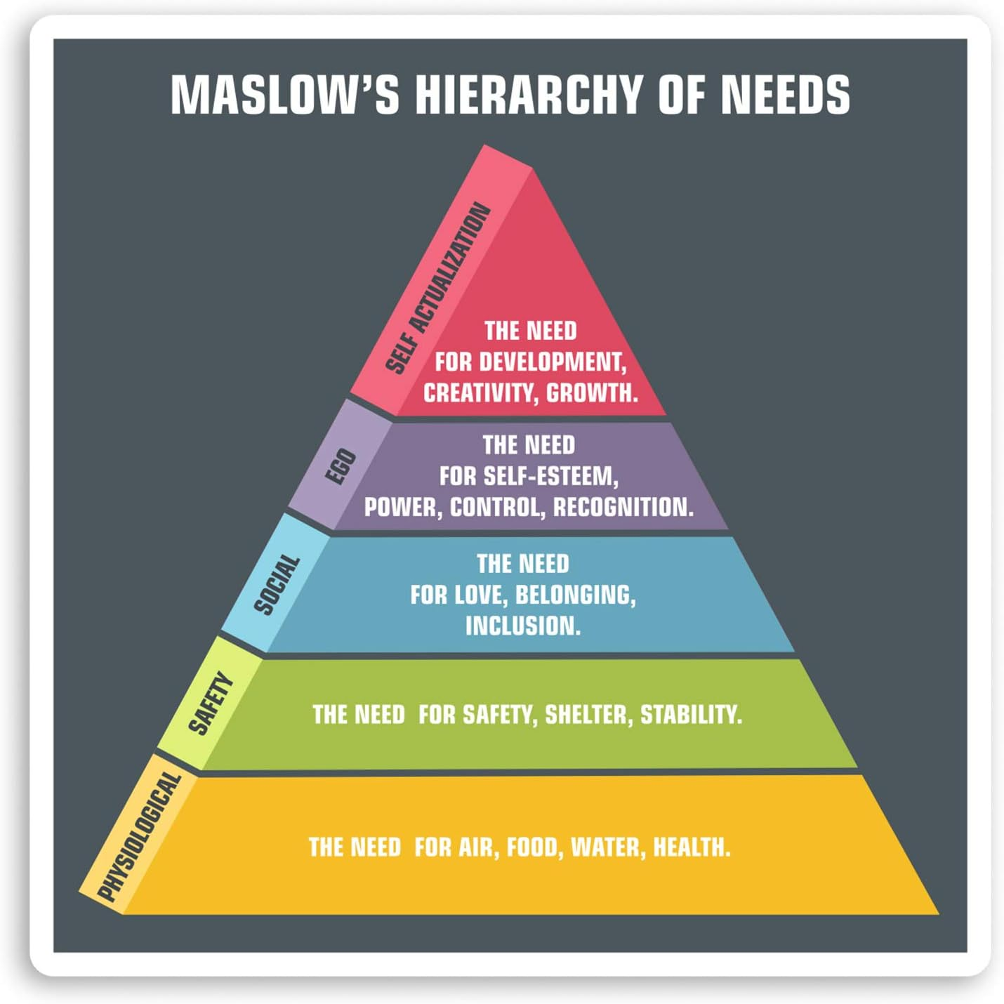
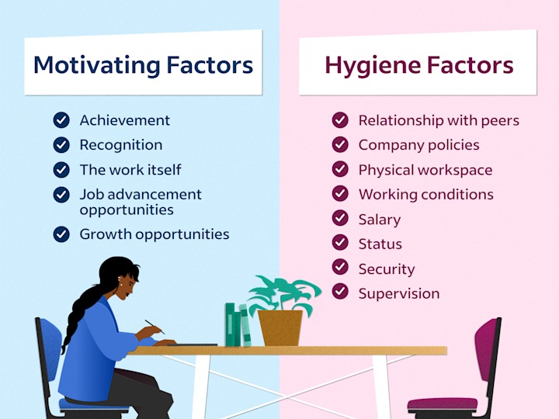
Motivation and human needs
SOUTH COAST
USER GROUP
23RD OCTOBER 2026

Slide 21
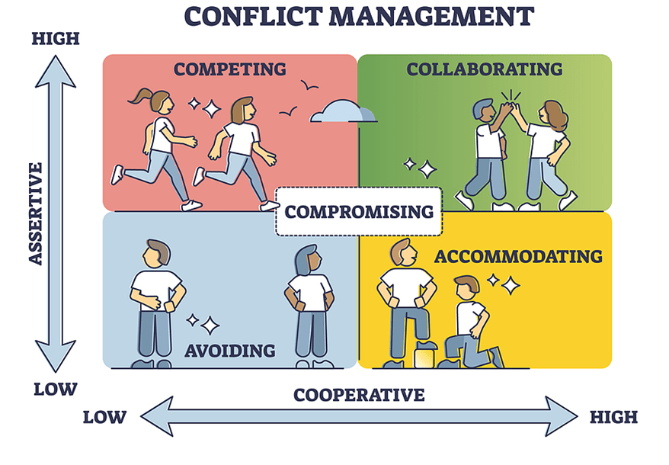
Conflict management
SOUTH COAST
USER GROUP
23RD OCTOBER 2026

Slide 22
Closing thoughts
SOUTH COAST
USER GROUP
23RD OCTOBER 2026
Consulting mindset
Client value
Delivery habits
Think, challenge and consult.
Develop human skills alongside technical skills.
Adapt leadership to the situation.
Prioritise value over functionality.
Question assumptions and find the why.
Free has a cost. More is not always better.
Use RAID and RAAIDD to protect delivery.
Think long term.
Treat others as you want to be treated.

Slide 23
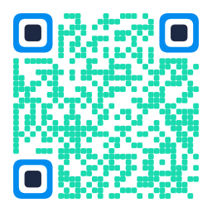
Questions & discussion
SOUTH COAST
USER GROUP
23RD OCTOBER 2026
What would you change in your consulting practice?
Thank you

Slide 24
Brand guidelines
Template reference
COLOUR PALETTE
TYPOGRAPHY
 | Mint #1BDBB0 | Headings
 | Blue #008BEF | Accents
 | Navy #1D2842 | Body text
 | White #FFFFFF | Content canvas
Krona One
Mint headings, blue emphasis and navy body text.
Keep a clear size hierarchy and room for text to breathe.
LAYOUT & LOGOS
Use the existing slide layouts and branded footer. Keep content above the footer. Preserve logo colours and proportions.
Notes:
Brand reference derived from the current South Coast User Group presentation template. Font: Krona One. Mint #1BDBB0, blue #008BEF, navy #1D2842 and white #FFFFFF are taken from editable slide and template objects. Logo artwork and footer remain inherited from the original layout/master. This is a working template reference, not an independently approved corporate brand manual.

